Slide 1

LLM Engineering
MASTER AI & LARGE LANGUAGE MODELS

Slide 2

TODAY
Week 2 commences
What you can already do
Intro to transformers, tokens, context windows, API costs etc
Contrast the leading Frontier LLMs
Confidently use the OpenAI API including streaming with markdown and JSON generation
After today you will be able to
Use OpenAI APIs to connect to many frontier model APIs
Use routers and abstraction layers
Write code that interacts between frontier LLMs

Slide 3


RECAP: YOUR 8 WEEK JOURNEY TO MASTERY
Week 3
Week 8
Week 3 - Open Source with HuggingFace
The Finale - Agentic AI
Week 4
LLM ENGINEER
Selecting LLMs and Code Generation
Week 2
Frontier Models with APIs, UIs and Multi-modality
Week 7
Week 1
Week 6
Fine-tuning an Open-Source Model
Foundations and the
Chat Completions API
Week 5
Fine-tuning a Frontier Model
RAG and Question Answering - Creating an Expert
YOU WERE HERE

Slide 4
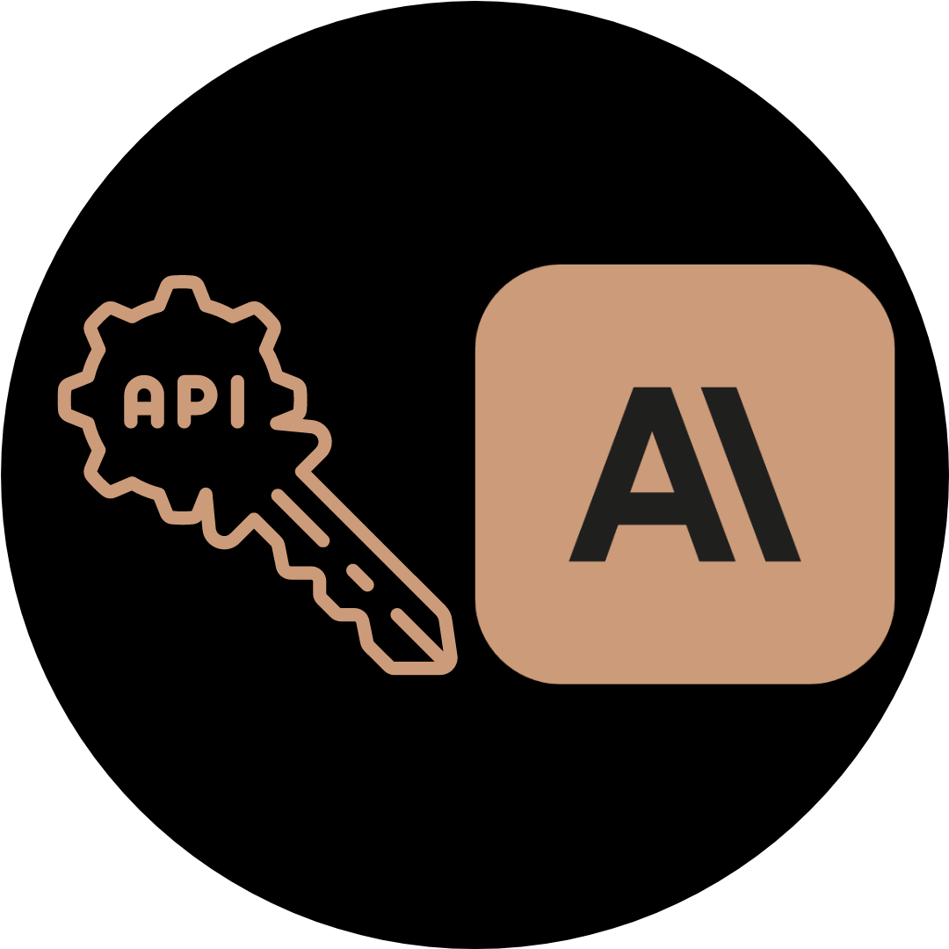


Setting up your environment (Optional)
Set up an Anthropic API Key
Set up a Google API Key
Update your .env file

Slide 5


ACTION!
00:10

Slide 6

PROGRESS
15% towards Mastering LLMs
What you can already do
Overview of transformers and the leading Frontier LLMs
Confidently use the OpenAI API including streaming with markdown and JSON generation
Use APIs to connect to frontier models
After tomorrow you will be able to
Describe Gradio, the remarkable platform for data science UIs
Create a simple UI using Gradio
Hook up Gradio to Frontier models

